Slide 1
Chapter 12 Project Stakeholder Management

Slide 2
Stakeholders
According to the Project Management Institute, the term project stakeholder refers to, "an individual, group, or organization, who may affect, be affected by, or perceive itself to be affected by a decision, activity, or outcome of a project". ISO 21500 uses a similar definition.

Slide 3
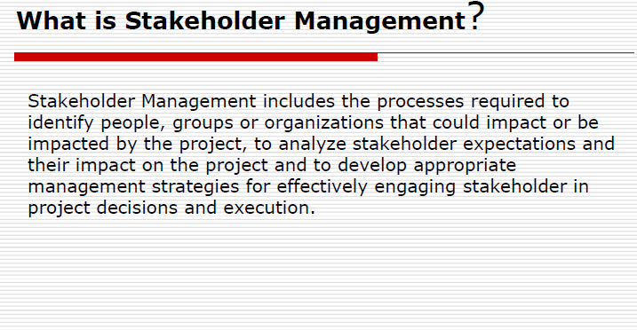

Slide 4
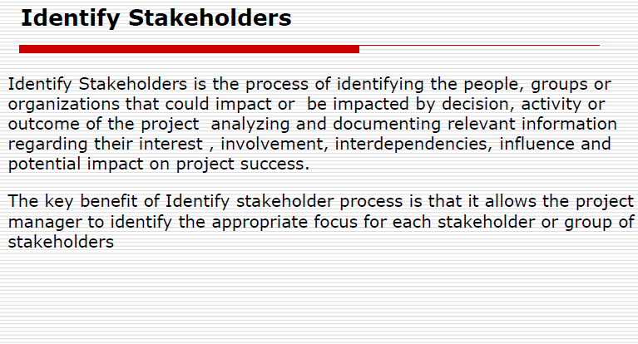

Slide 5
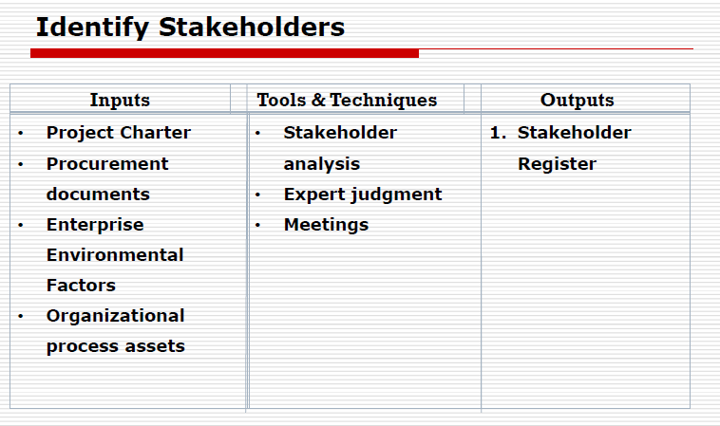

Slide 6
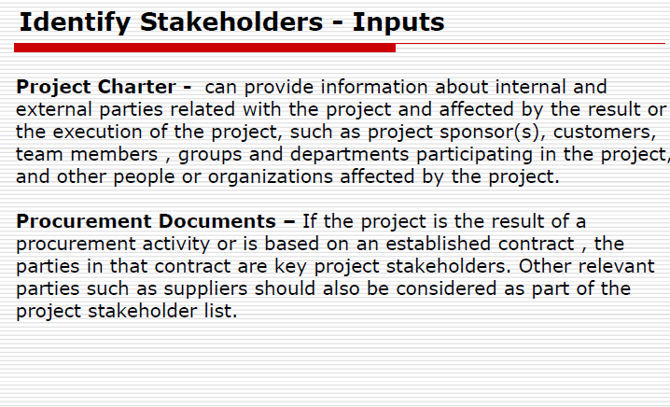

Slide 7
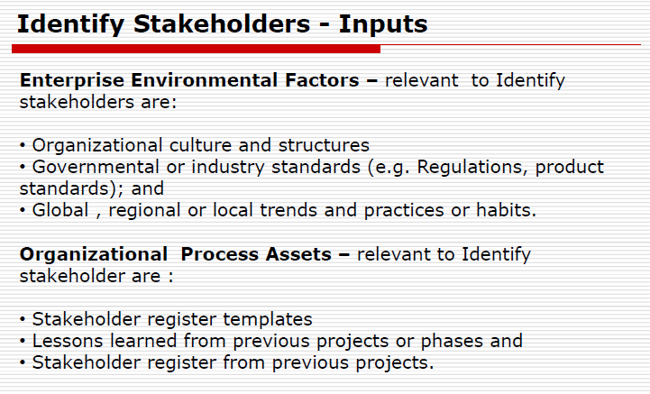

Slide 8
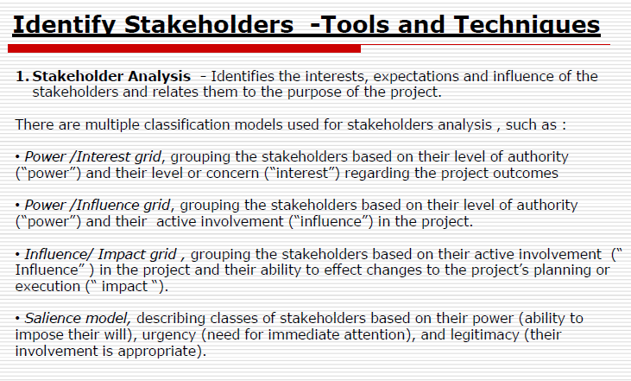

Slide 9
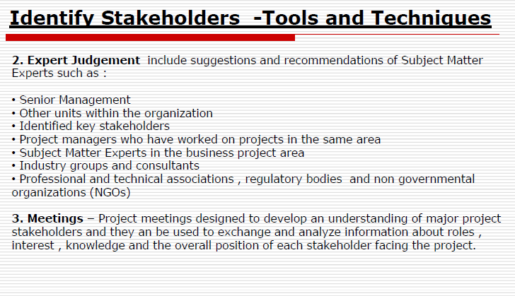

Slide 10
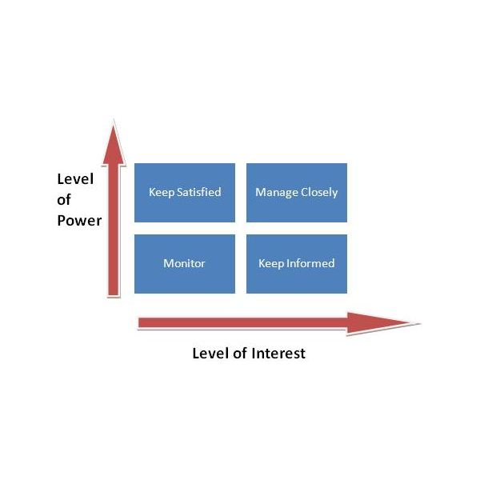
Power/Interest Grid Matrix

Slide 11
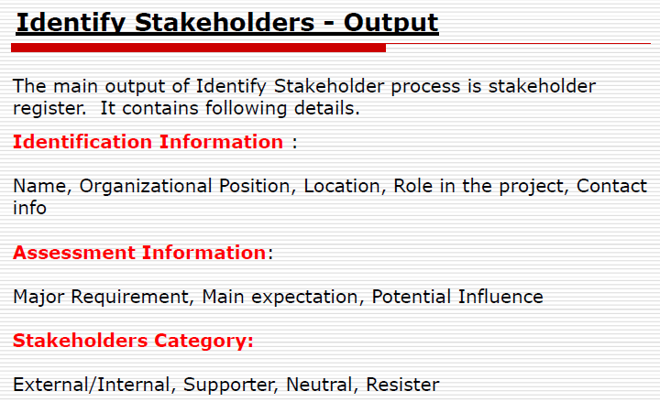

Slide 12
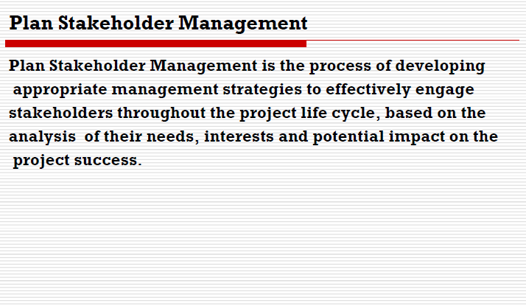

Slide 13
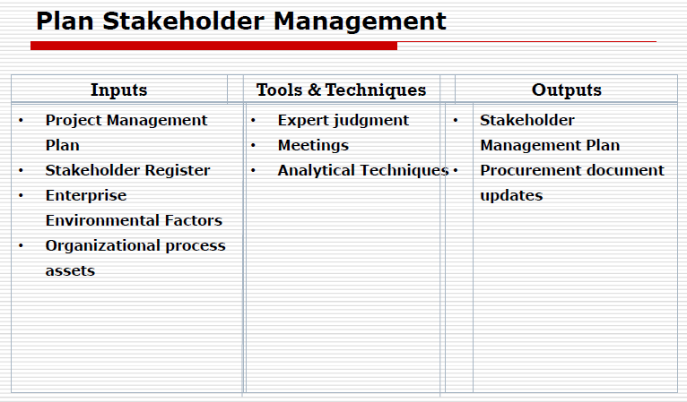

Slide 14
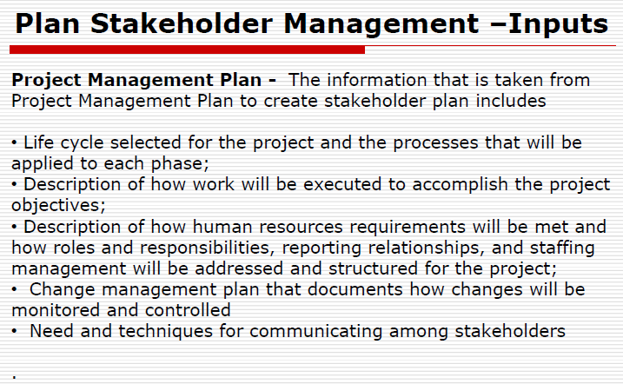

Slide 15
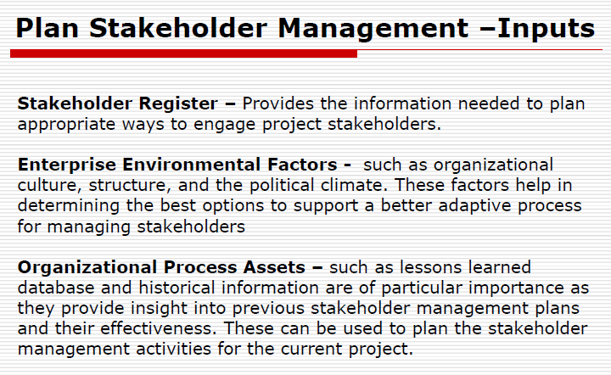

Slide 16
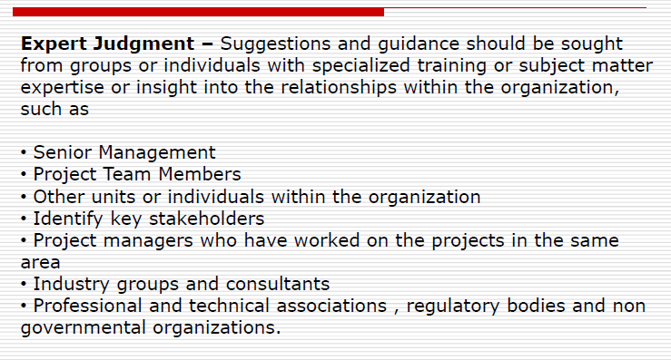
Tools and Techniques

Slide 17
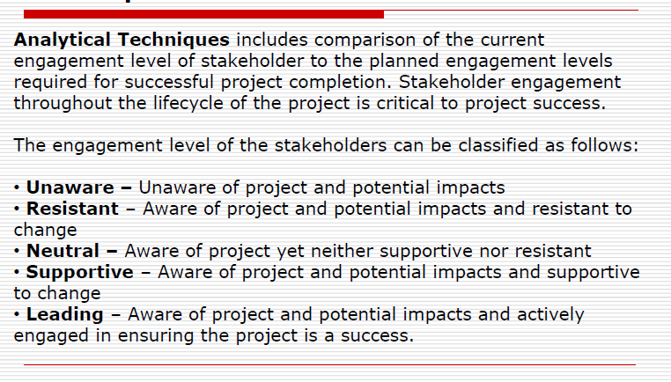
Tools and Techniques

Slide 18
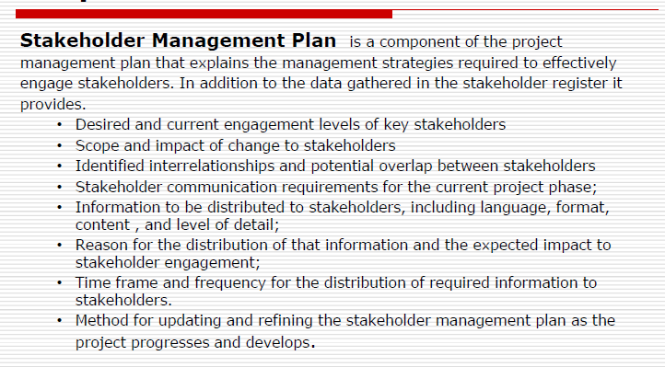
Outputs

Slide 19
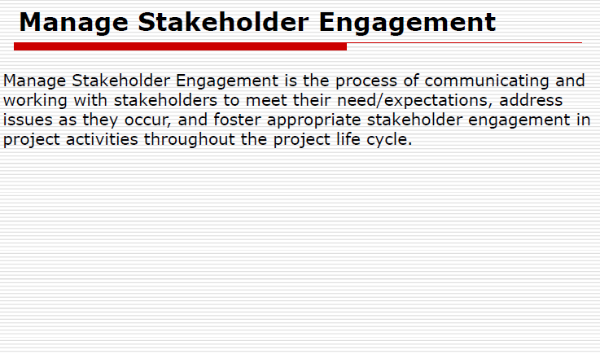

Slide 20
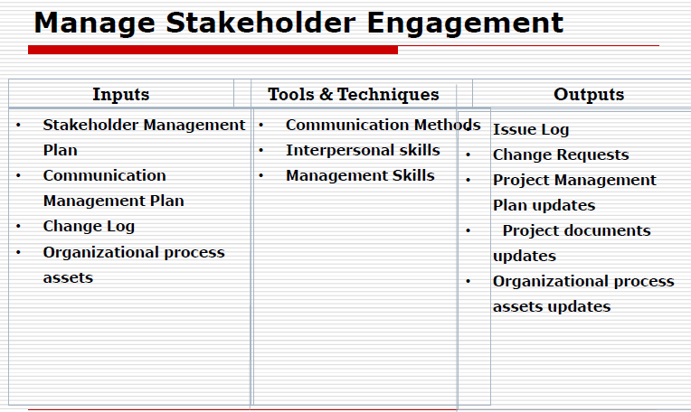

Slide 21
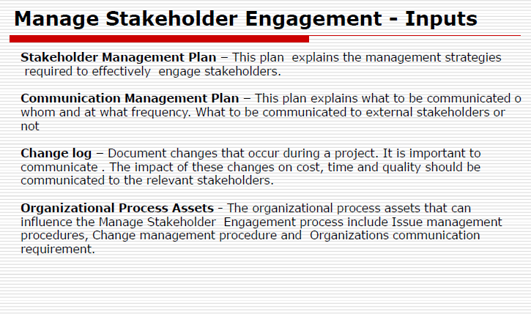

Slide 22
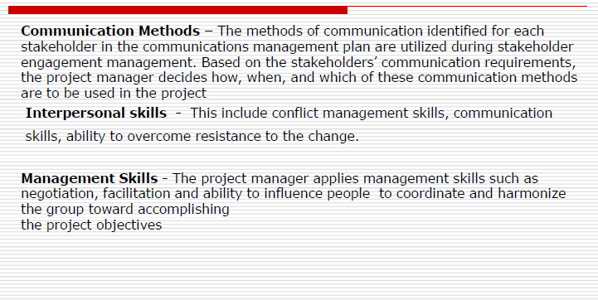
Tools and Techniques

Slide 23
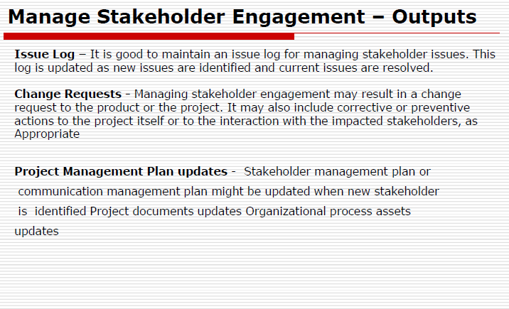

Slide 24
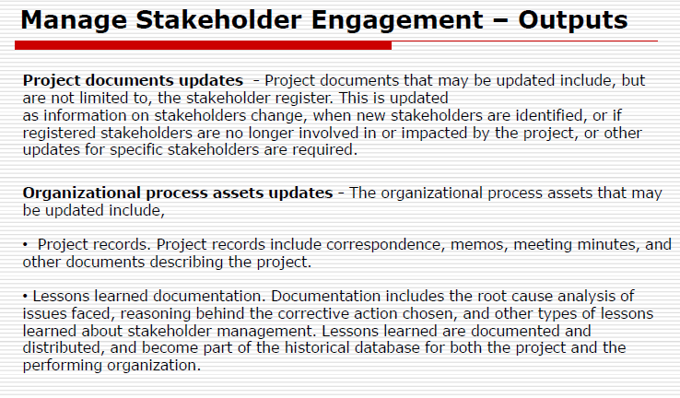

Slide 25
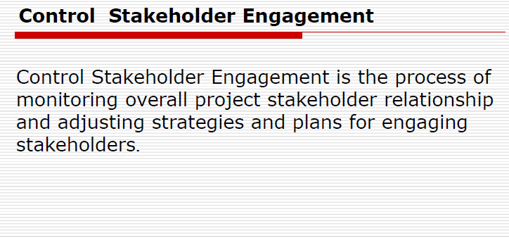

Slide 26
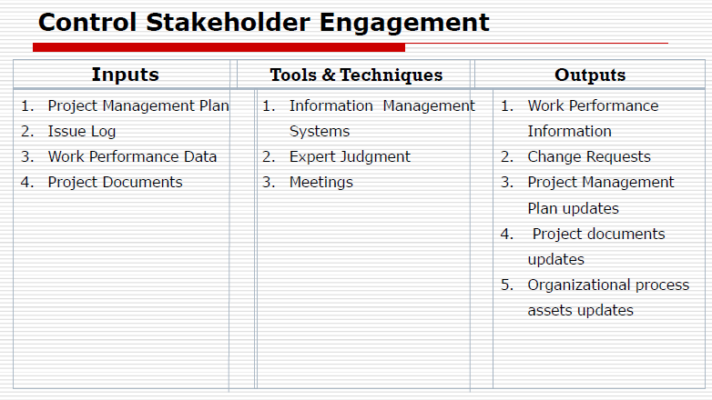

Slide 27
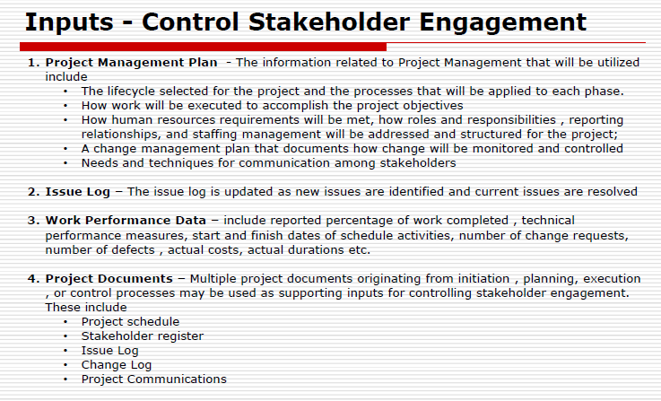

Slide 28
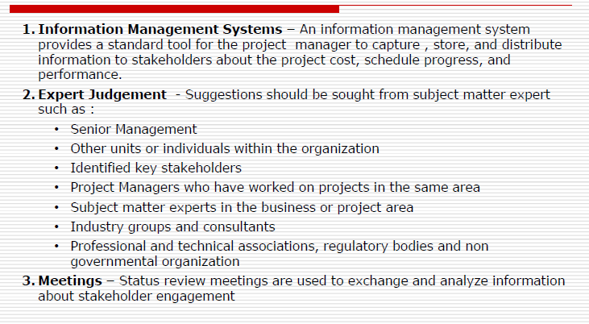
Tools and Techniques

Slide 29
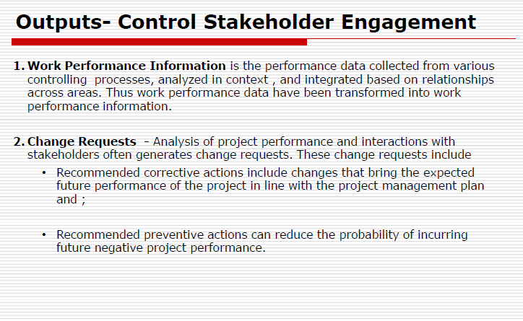

Slide 30
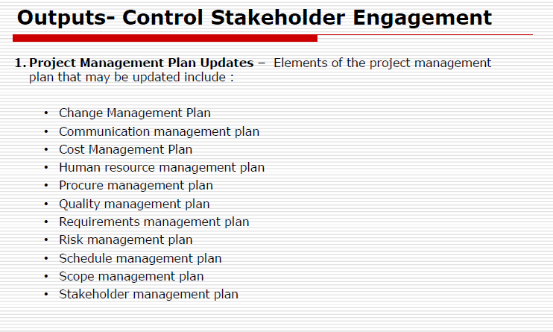

Slide 31
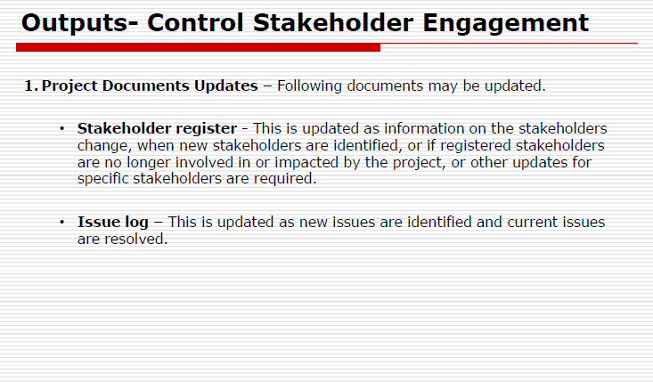

Slide 32
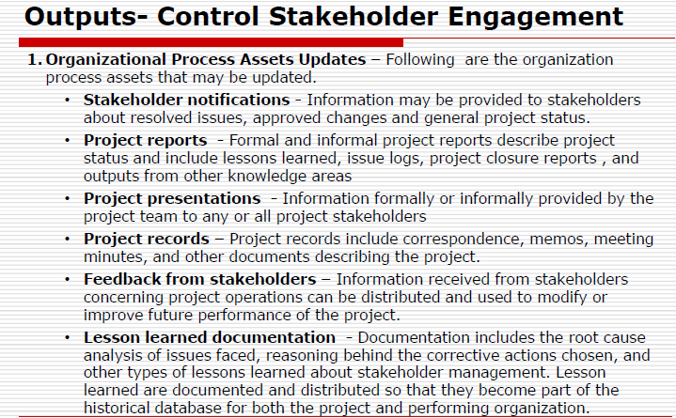

Slide 33
Chapter 13
Project Procurement Management

Slide 34
Project procurement management
Project procurement management is the creation of relationships with outside vendors and suppliers for goods and services needed to complete a project.
This process is comprised of five steps, including initiating and planning, selecting, contract writing, monitoring, and closing and completing.

Slide 35
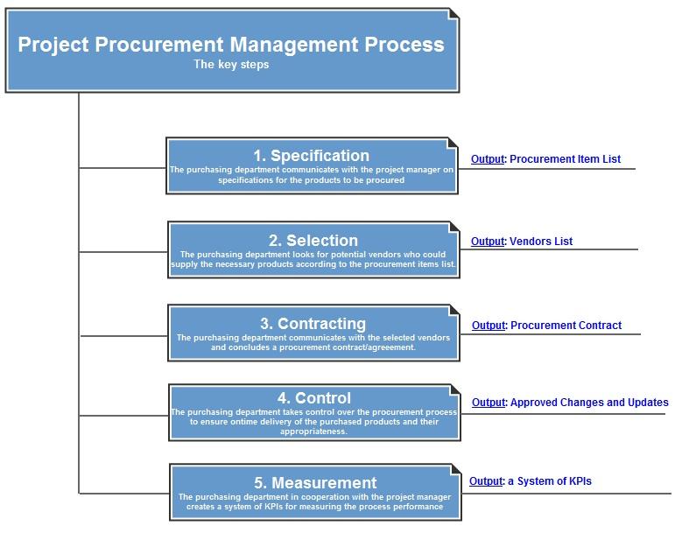

Slide 36
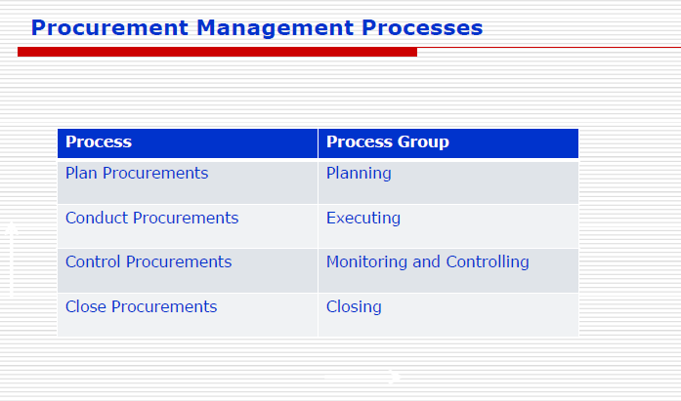

Slide 37
Procurement Plan
Process of documenting project purchasing decisions, specifying the approach, and identifying the potential sellers.

Slide 38
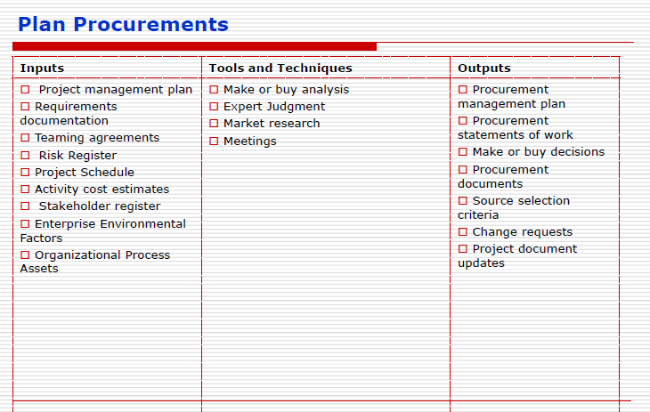

Slide 39
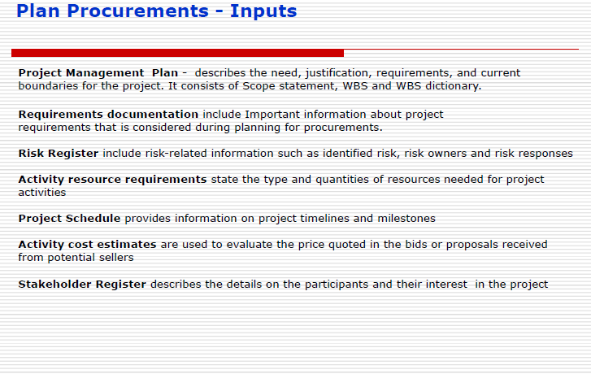

Slide 40
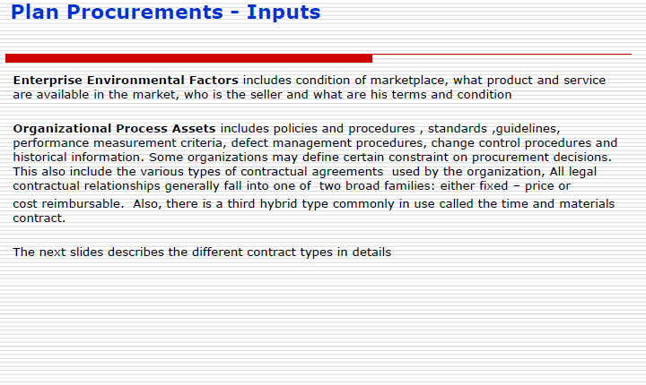

Slide 41
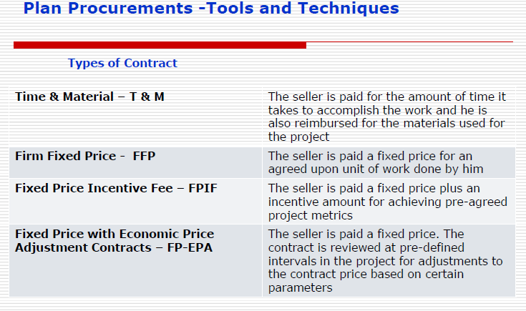

Slide 42
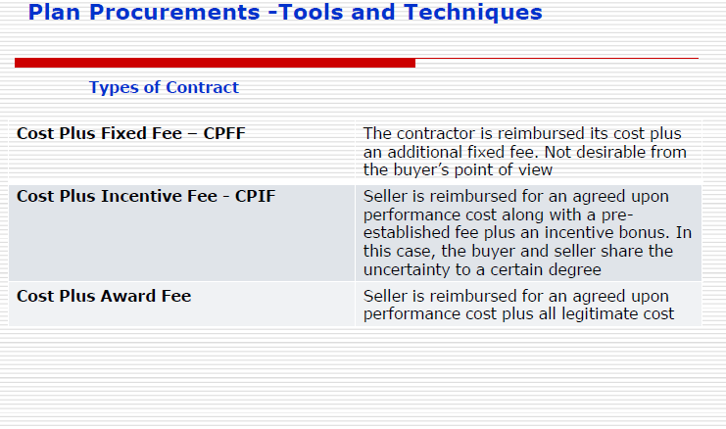

Slide 43
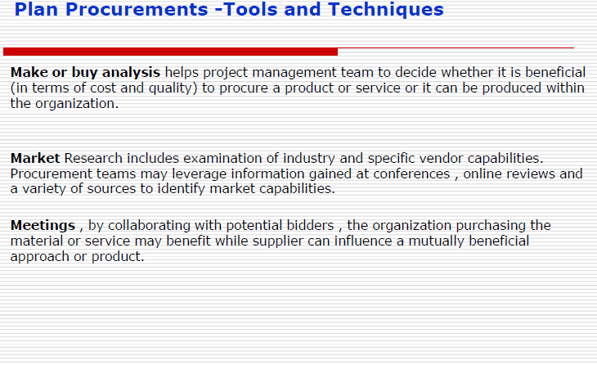

Slide 44
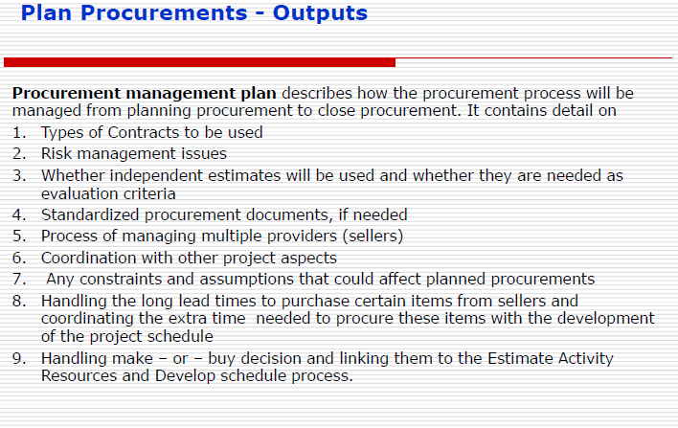

Slide 45
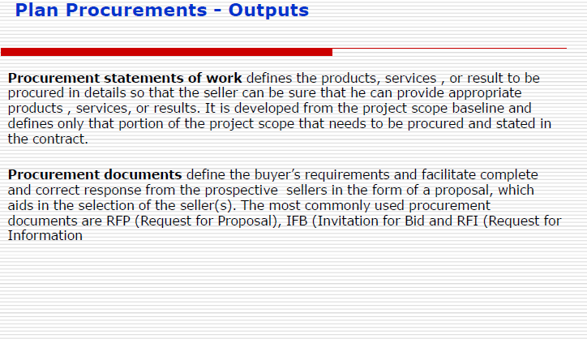

Slide 46
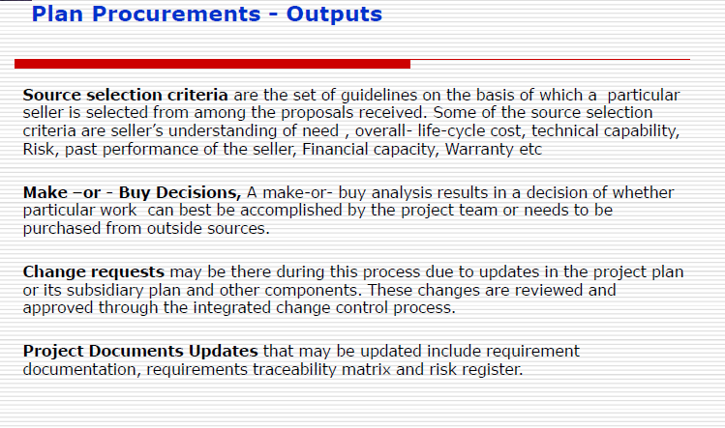

Slide 47
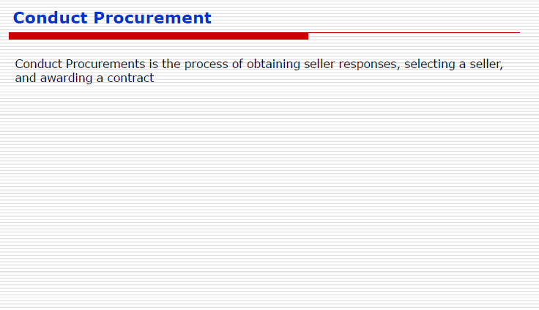

Slide 48
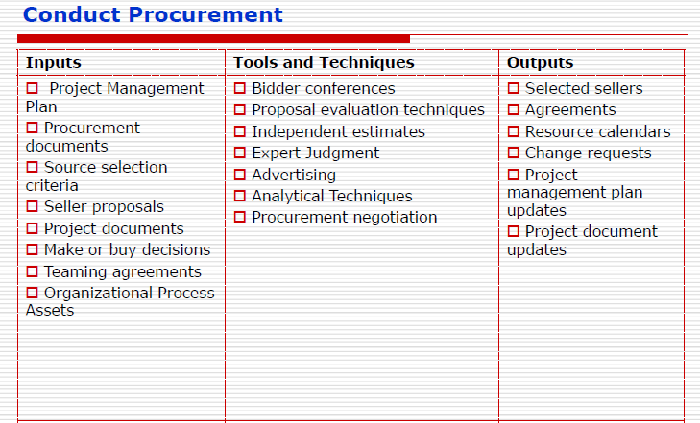

Slide 49
Control Procurement
Managing procurement relationships, monitoring contract performance and making changes and corrections as per need.

Slide 50
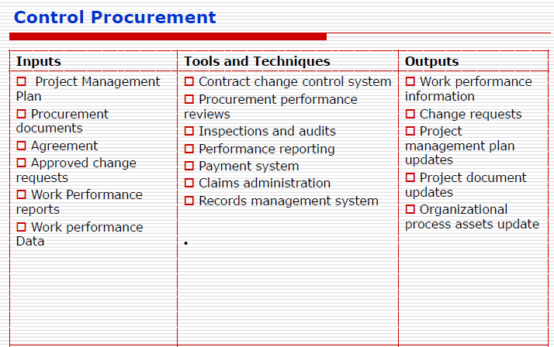

Slide 51
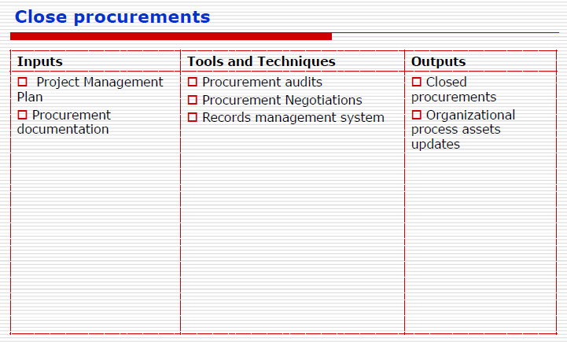

Slide 52
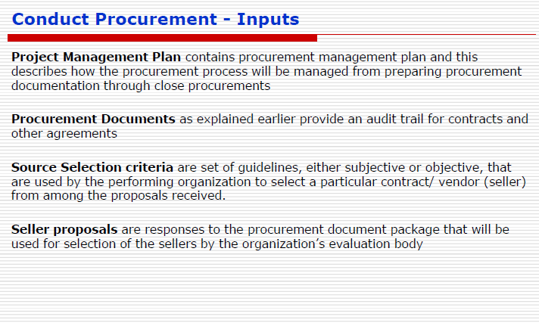

Slide 53
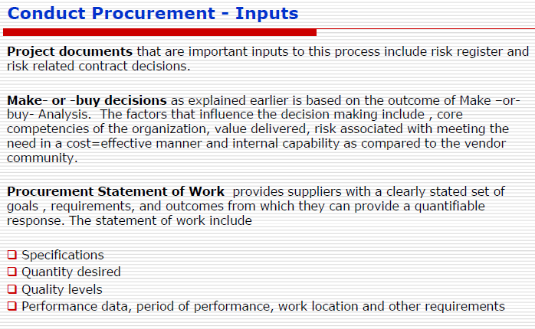

Slide 54
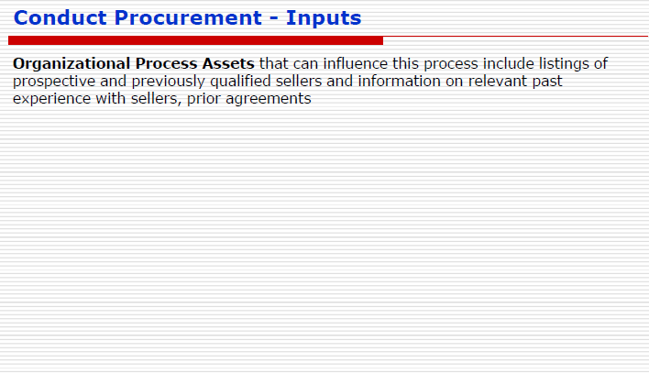

Slide 55
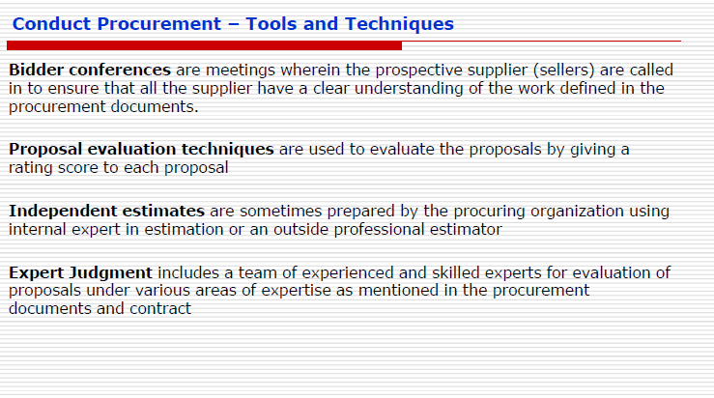

Slide 56
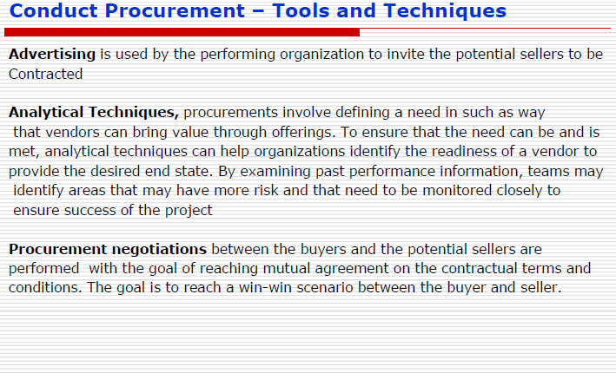

Slide 57


Slide 58


Slide 59


Slide 60


Slide 61


Slide 62


Slide 63


Slide 64


Slide 65


Slide 66


Slide 67


Slide 68


Slide 69


Slide 70


Slide 71


Slide 72


Slide 73


Slide 74


Slide 75


Slide 76


Slide 77

Good Luck

